Slide 1
Virtual Speech and Debate, What it Provided and Where It is Going
Greg Cunningham – president, Massachusetts speech and debate league

Slide 2
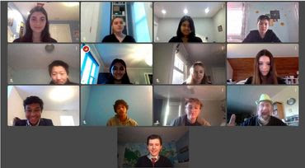
Online tournaments – how did we get here
First national tournament to move online – Toc (April 16-20)
First major use of classrooms.cloud/zoom (combined synchronous/ asynchronous)
Msdl 2020 state speech and debate finals held online (may 23-24)
Zoom and First use of nsda campus (synchronous)

Slide 3
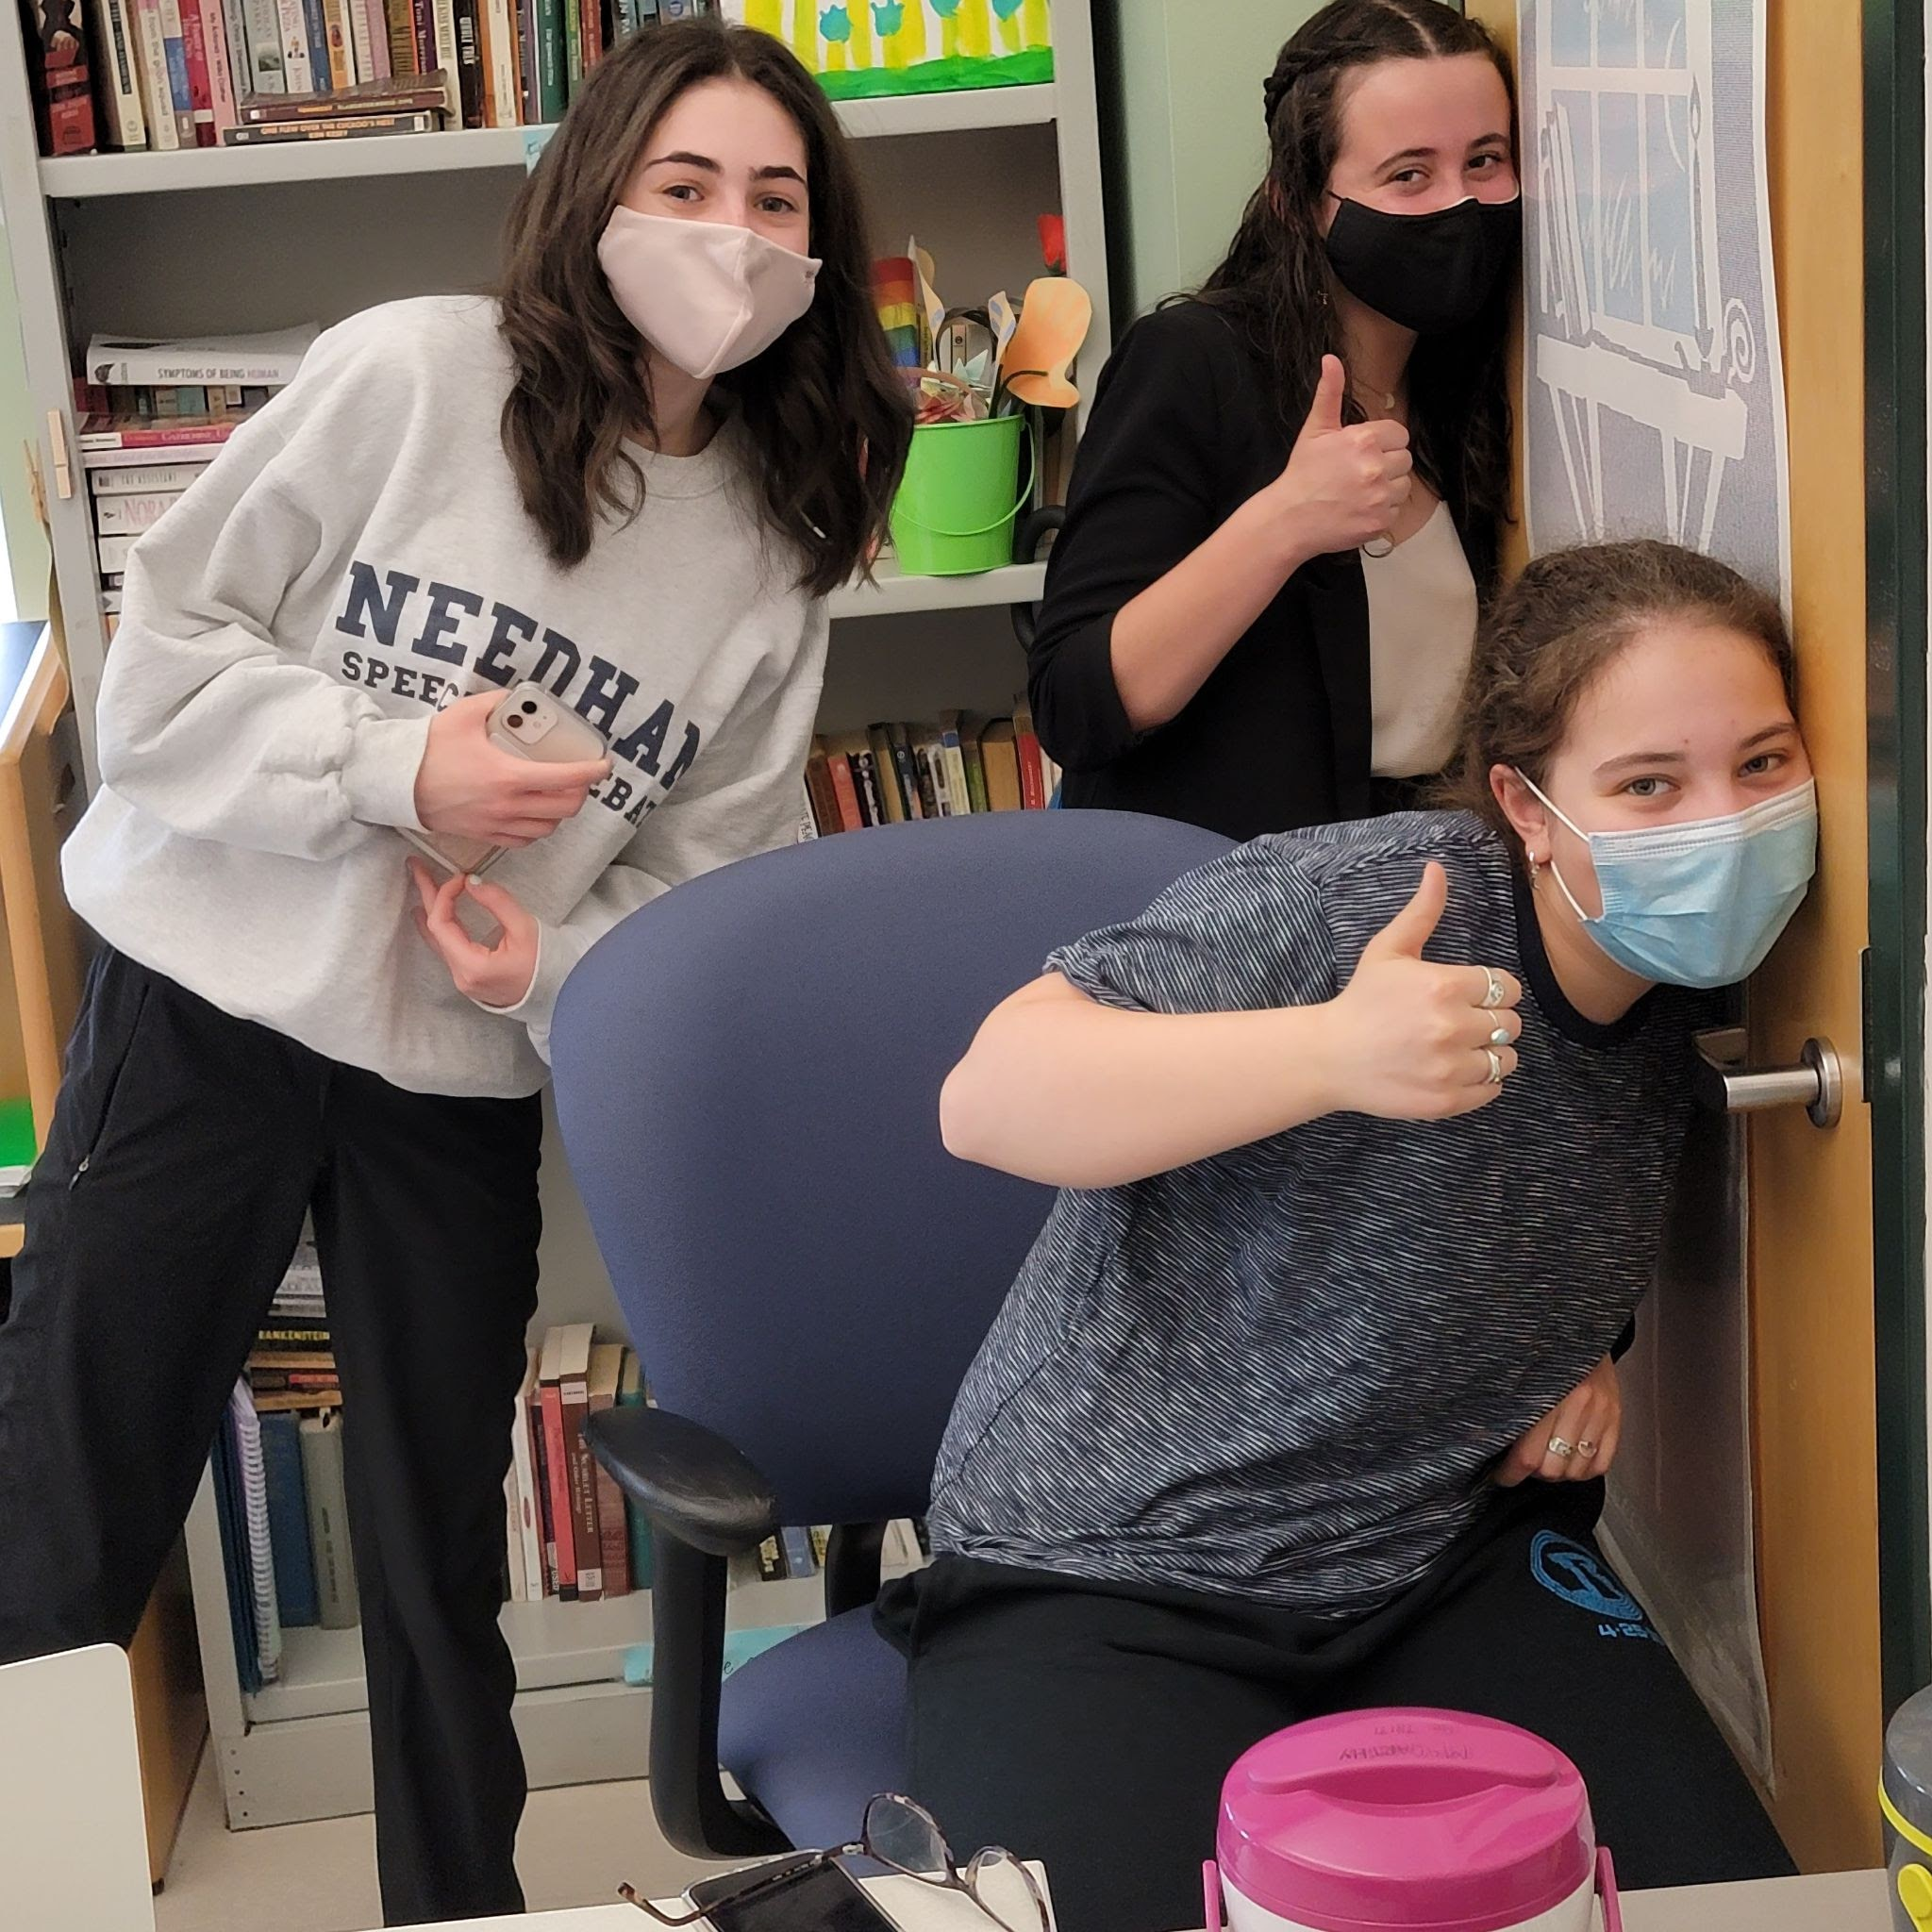
What did we learn
Our students are resilient!
Debate and non-dramatic speech events work online
Dramatic events, especially duo, did not always translate well to the screen
In-person still works best
Some equity issues were resolved when travel was not necessary, but other new equity issues emerged in terms of technology access.

Slide 4
What did we learn
Some rules are much harder to enforce
Congress needs to be in small groups (up to 12 students)
Flighting is really hard - schedules and judge quotas need to be adjusted
LiveDocs or live updates are really helpful and are something to keep even when we return in-person.
It is harder for an audience to watch rounds
National tournaments need schedules for all time zones
Delivery of trophies is hard!

Slide 5
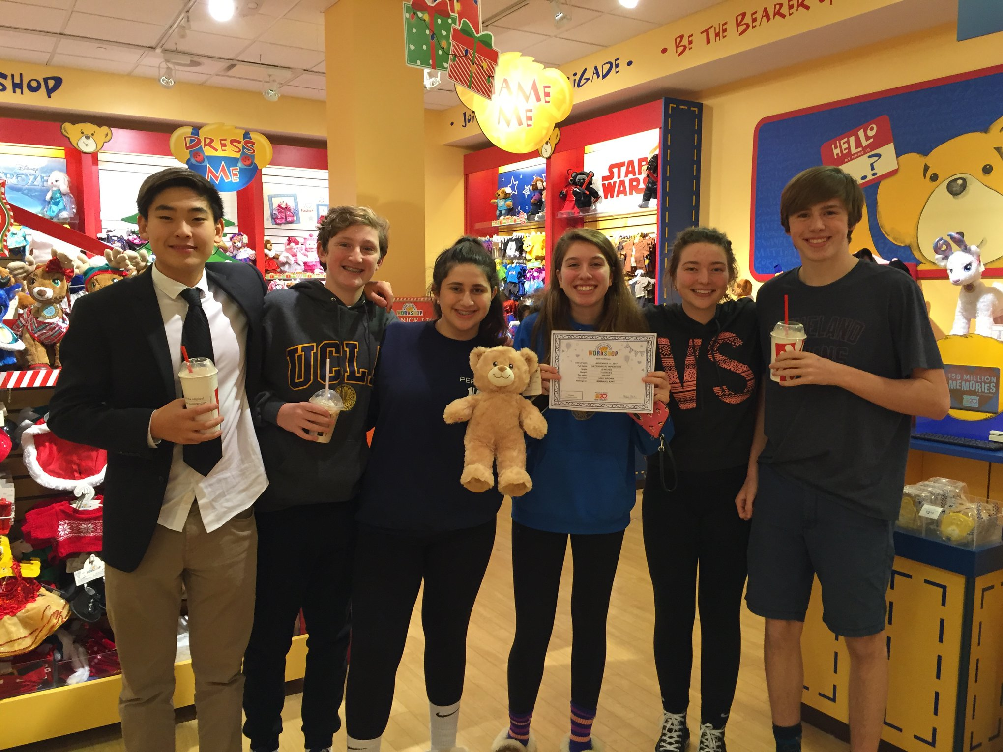
Conclusion – what did we learn
In-person tournaments work best and allow for interaction and socialization from which our students thrive
Online tournaments and the invention of online platforms saved our activity during the pandemic

Slide 6
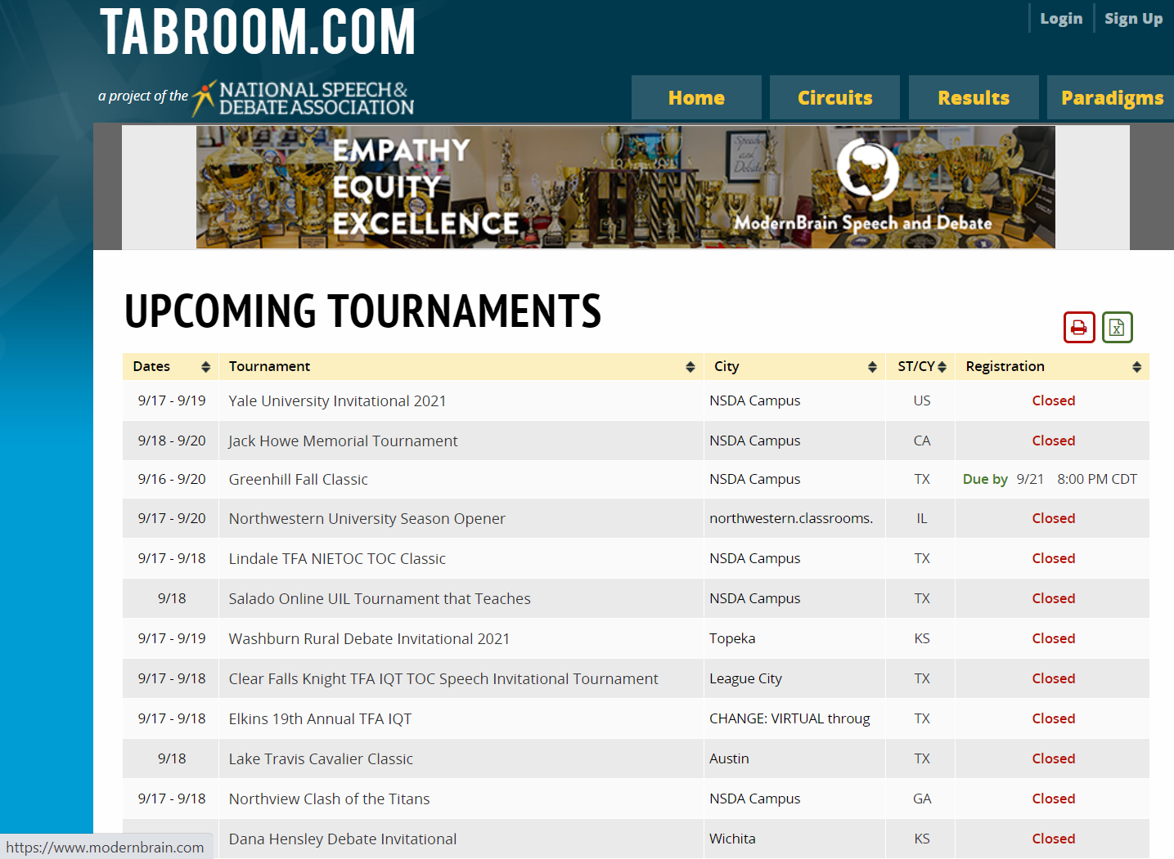
Where are we
Many leagues have returned or plan to return to in-person tournaments this year
Some leagues have begun the year online and hope to move to in-person at some point during the season
For last two weekends in September, 48 of 72 tournaments listed on tabroom.com are being held online (about 2/3)
Glenbrooks, emory, villiger tournaments have all announced they will be held online

Slide 7
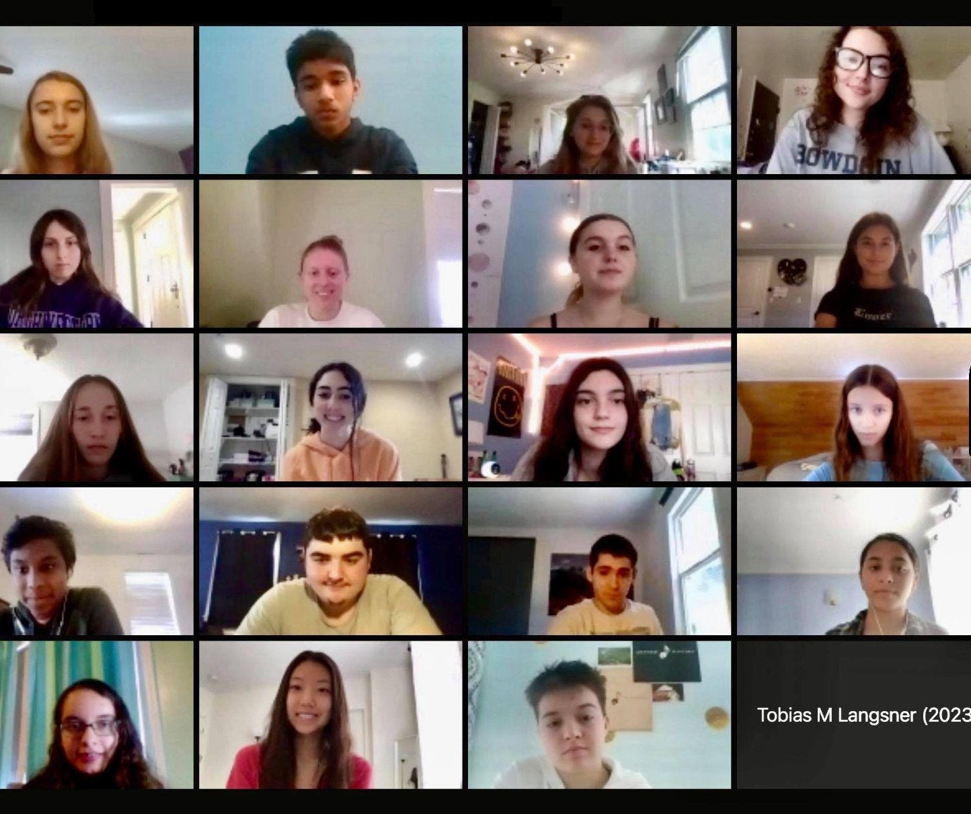
Where do we go from here: online tournaments continue
Seek ways to increase equity so all students may participate
Adjust rules as necessary and update judge handbooks and training with online specific information
Allow students to compete from schools rather than homes
Find more ways to make viewing rounds accessible to a wider audience
Figure out a way to effectively deliver awards (please!)

Slide 8
Where do we go from here – the after times
Use Virtual sessions for Judge Training and/or Student orientation, Especially at the start of the competition year.
hybrid tournaments be expanded in high- traffic-trouble areas. Possibly hold Friday night competition online and Saturday competition in person.
How do we get judges out of bed and into a building again?!

Slide 9
Where do we go from here – the after times
Can some tournaments (especially those lacking competition space) be hybrid? (Some events in person, some events online)?
Would a round work if some were in person and some online?
Can we eliminate the use of paper in some events and use electronic documents instead (Radio and Extemp)?
When inclement weather would normally force the postponement or cancellation of an in-person tournament, could it be moved online?

Slide 10
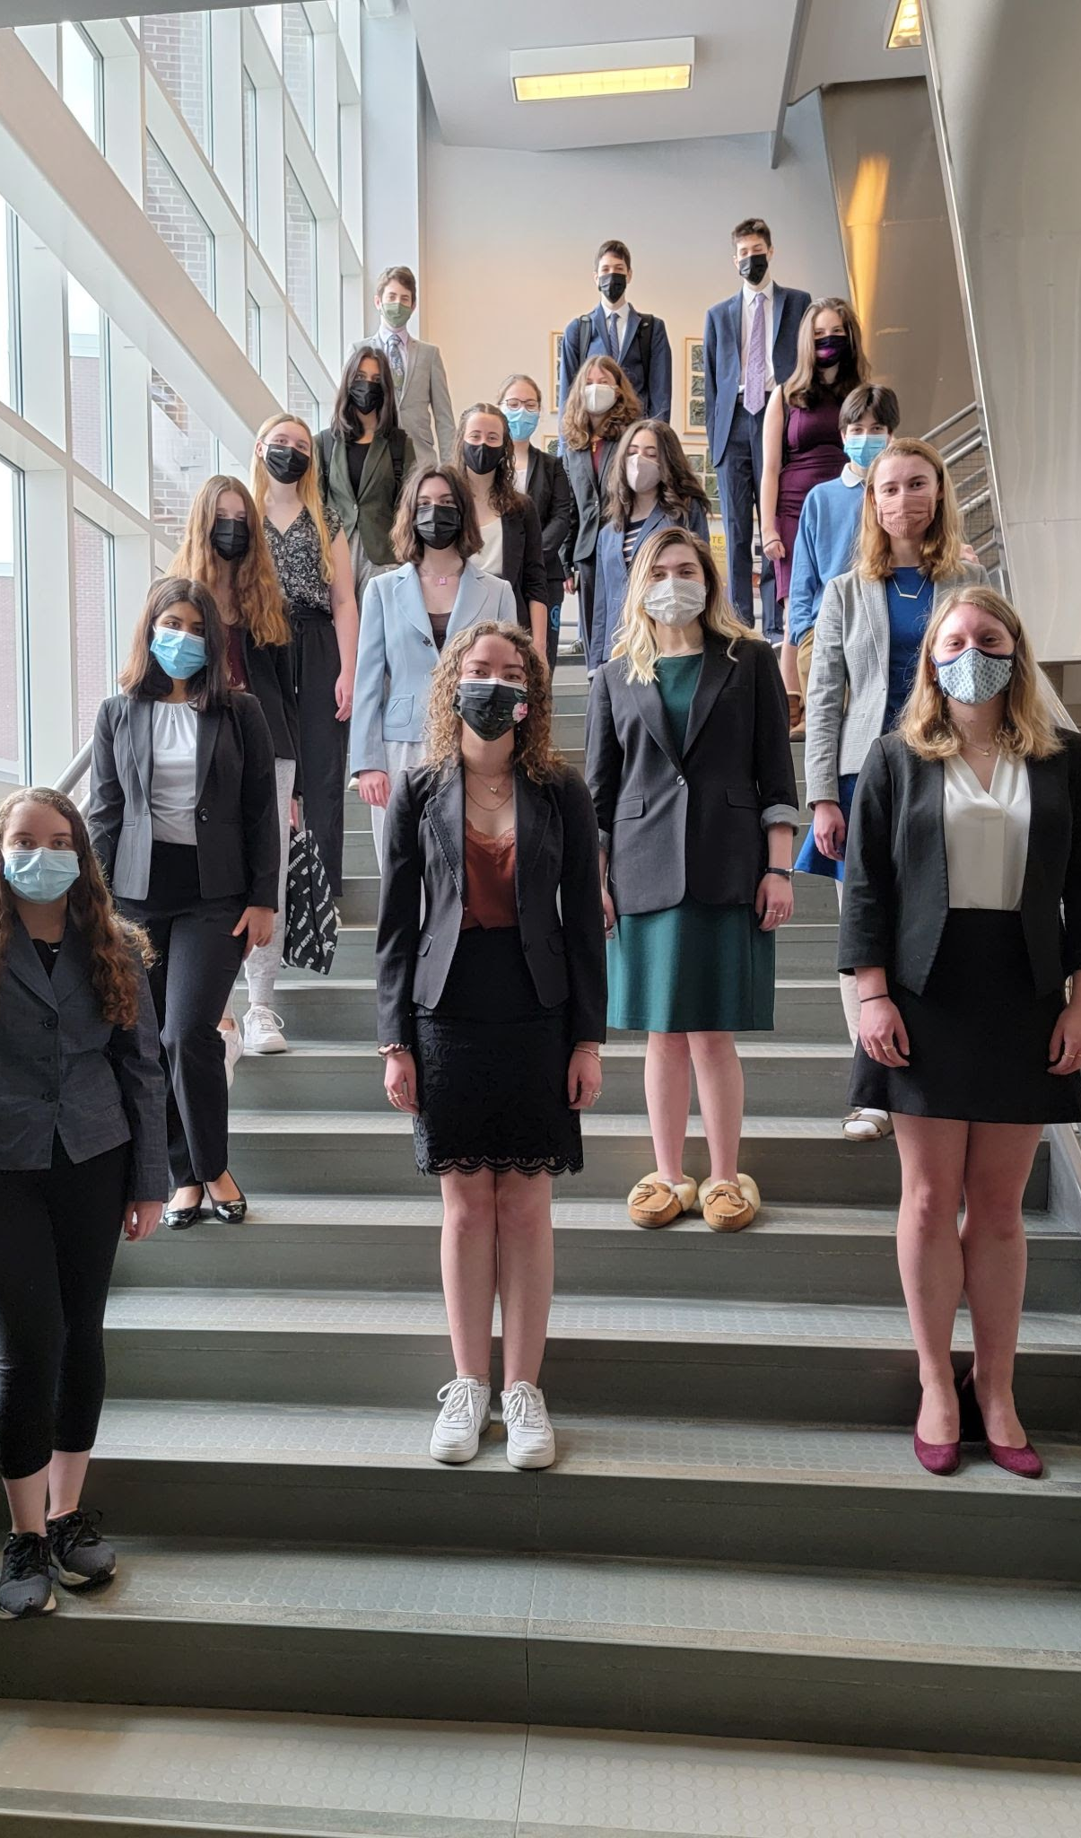
We are (still) all in this together
Whether online or in-person, it is always important to realize the activity helps students develop their voices
Tournaments do not have to be perfect to be good
When we put the students first, great things always happen

Slide 11
Thank you to nfhs for their support (especially james, kyle and jana!) and for the opportunity to share these thoughts!

