Slide 1
NFHS Performing Arts Conference

Slide 2
Recruiting Adjudicators
Thursday, Sept. 22, 2021
Denver, CO

Slide 3
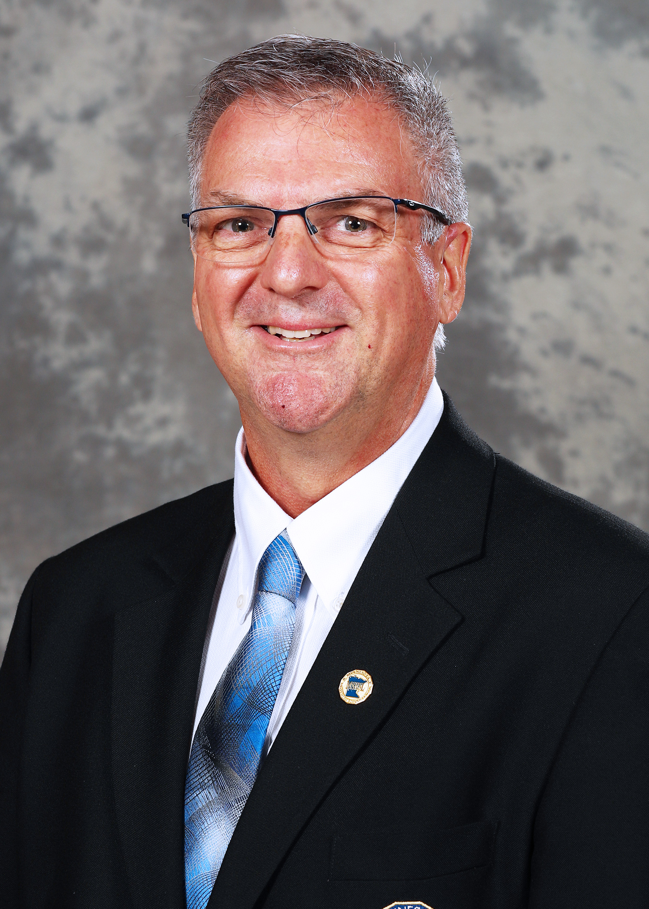
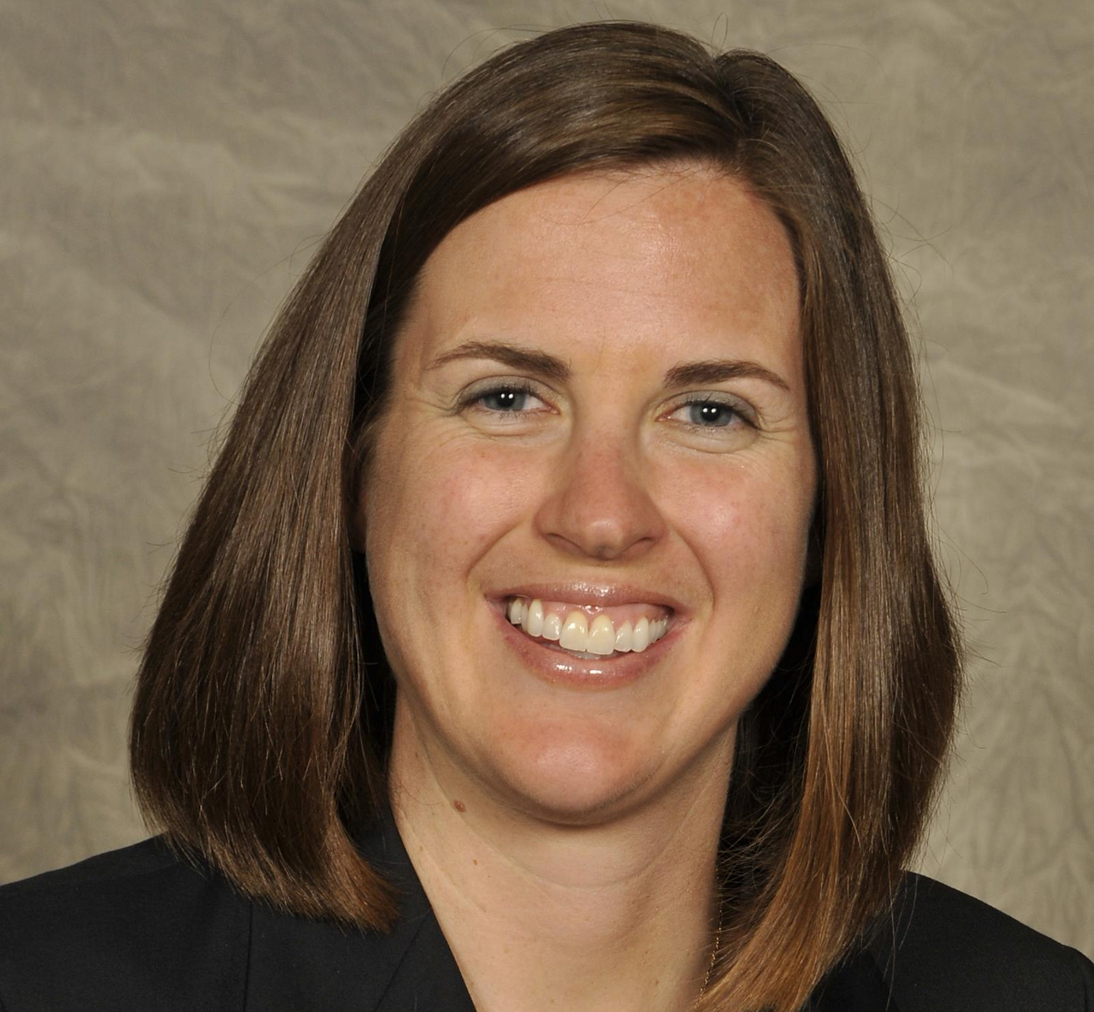
* Tim Leighton, MSHSL * Bethany Brookens, CHSAA * Rashaan Davis, CHSAA

Slide 4
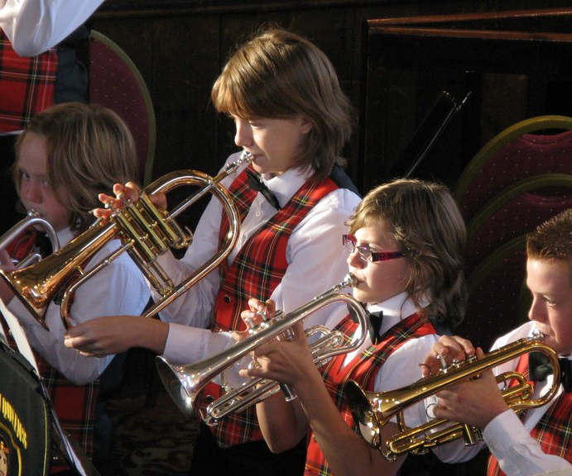
The joys and harmony of students and music
This Photo by Unknown Author is licensed under CC BY-NC-ND
This Photo by Unknown Author is licensed under CC BY-NC-ND

Slide 5
The current state of adjudicating in our schools

Slide 6
Adjudicating requirements
This Photo by Unknown Author is licensed under CC BY-NC-ND

Slide 7
Deliberate recruiting processes
This Photo by Unknown Author is licensed under CC BY-SA

Slide 8
Who makes a great adjudicator?

Slide 9
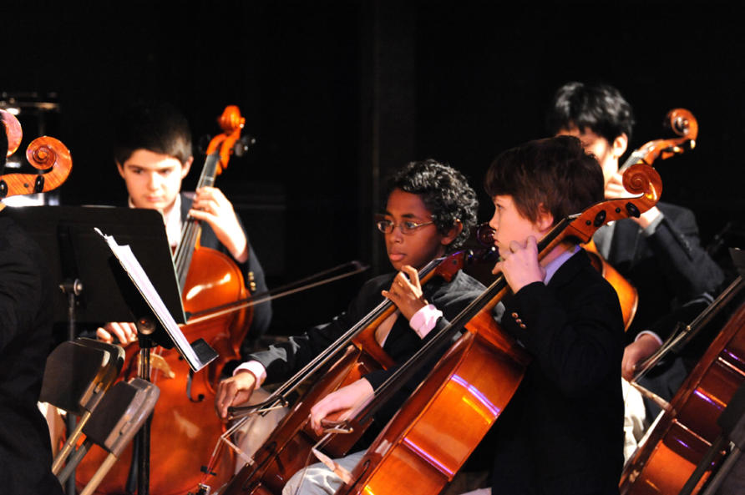
Diversity and Inclusion in Adjudicating
This Photo by Unknown Author is licensed under CC BY-ND

Slide 10
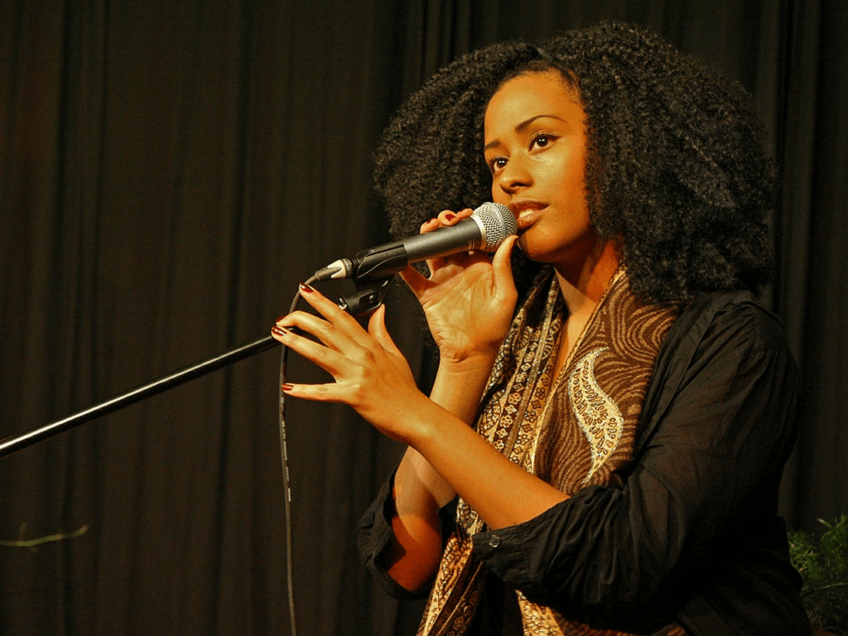
Adjudicating training
This Photo by Unknown Author is licensed under CC BY-SA
This Photo by Unknown Author is licensed under CC BY-ND
This Photo by Unknown Author is licensed under CC BY

Slide 11
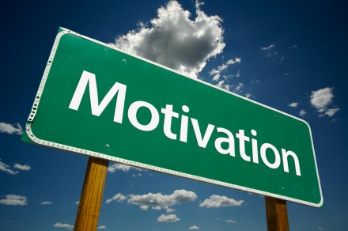
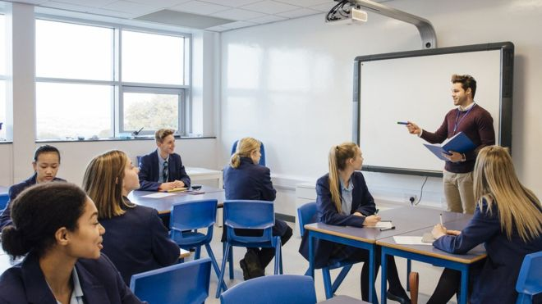
Keeping adjudicators motivated
This Photo by Unknown Author is licensed under CC BY-NC-ND
This Photo by Unknown Author is licensed under CC BY

Slide 12
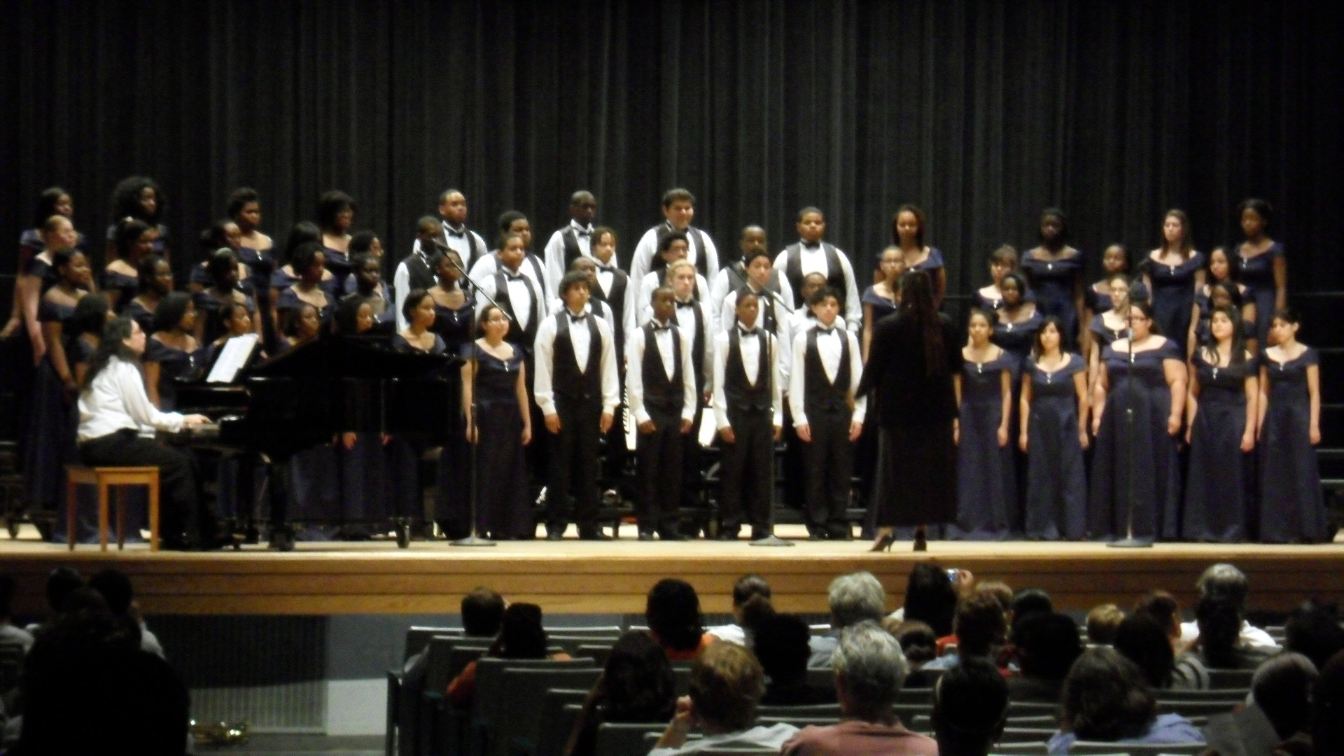
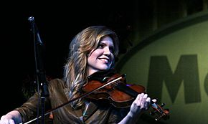
FINE
This Photo by Unknown Author is licensed under CC BY-SA
This Photo by Unknown Author is licensed under CC BY-SA
Thank you for your support and dedication to Music in the schools!

