Slide 1

Music Moves Our World

Slide 2
What We’ll Cover
What is a Copyright?
Performing Rights Organizations (PROs) - service organizations
The PRO landscape
How does BMI collect and distribute licensing fees?
BMI and NFHS Partnership
What’s Licensable?
New BMI License for Primary & Secondary Schools
Many thanks!

Slide 3

“Twist & Shout”
Phil Medley
Bert Russell

Slide 4


Slide 5
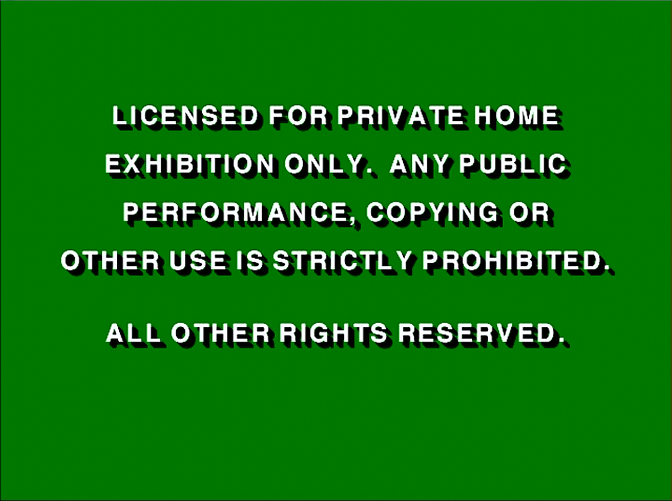
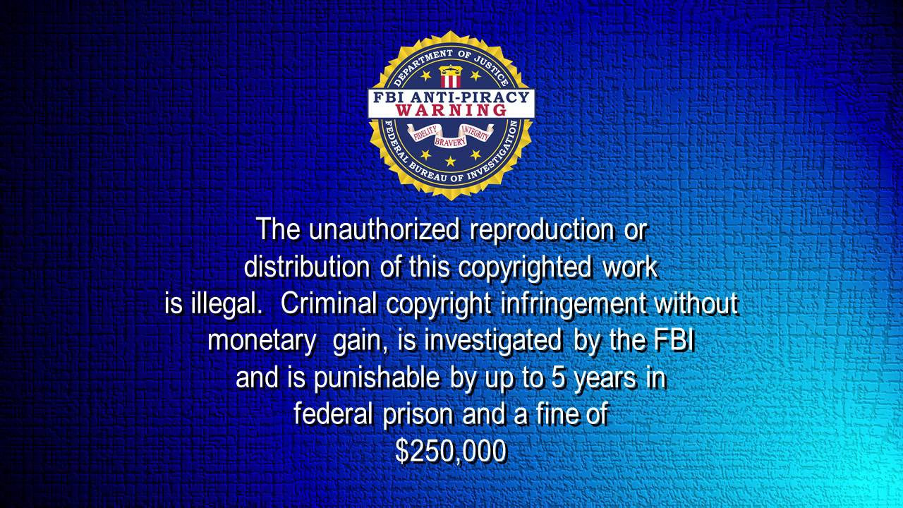
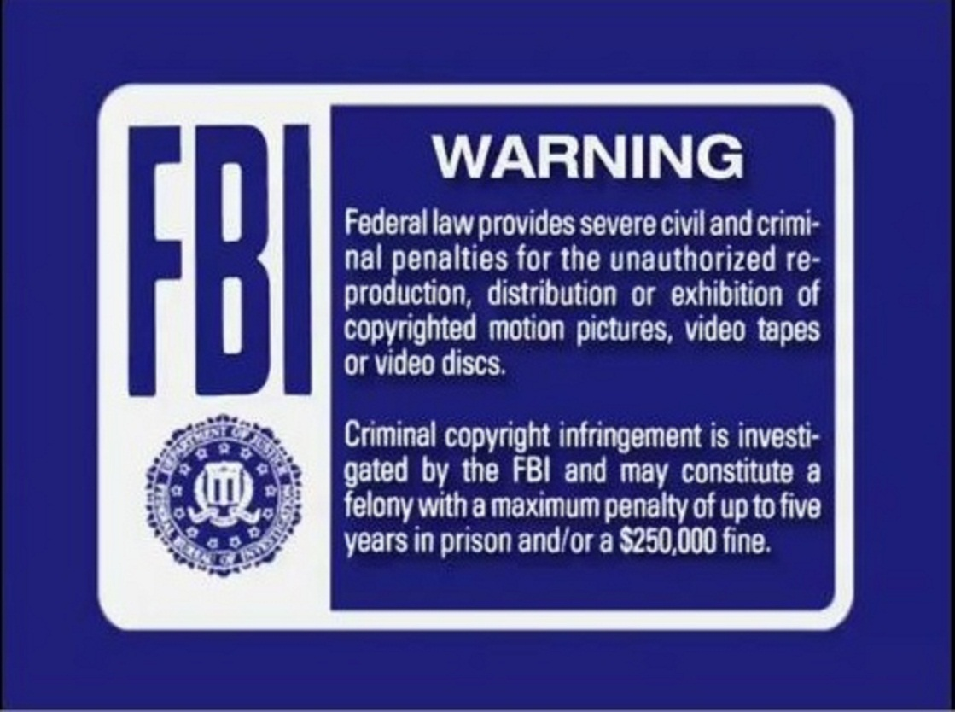

Slide 6
Know Your Musical Copyrights
Right To Reproduce (Mechanical)
Right To Prepare Derivative Works (Synch)
Right To Distribute
Right To Perform Publicly
  “Public” is defined as any group outside your normal circle of family and friends.
  Music is the property of its creator.
  Permission is required for its public use.

Slide 7

Music Creators and Music Users
Songwriters
&
Composers
CREATE
the work.
Publishers OWN
the work.
Organizations publicly perform music.
How do they get the permission from the creators?
The bridge between music creators and music users.

Slide 8


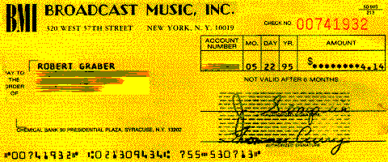
How It Works
Songwriters Join
Kenny Chesney
Taylor Swift
Lady Gaga
Dolly Parton
Sting
Maren Morris
Jack Ingram
License & Collect
Schools/Colleges
Restaurants
Bars
Hotels
Fitness Clubs
Radio/TV
Live Concerts
Festivals & Events
Pay Royalties
Songwriters
Publishers
Composers
Track Performances
Radio
TV
Films
International
Internet

Slide 9

Track & Pay on Performances

Slide 10

The American Society of Composers, Authors and Publishers
Founded in 1914
Owned and governed by members
Not-for-profit
Consent Decree
700,000+ members
Royalties paid quarterly

Slide 11

The American Society of Composers, Authors and Publishers
Founded in 1914
Owned and governed by members
Not-for-profit
Consent Decree
700,000+ members
Royalties paid quarterly
Broadcast Music, Inc.
Founded in 1939
Board comprised of broadcasters
Not-for-profit
Consent Decree
1.2 million affiliates
Open door policy
Royalties paid quarterly

Slide 12

The American Society of Composers, Authors and Publishers
Founded in 1914
Owned and governed by members
Not-for-profit
Consent Decree
700,000+ members
Royalties paid quarterly
Broadcast Music, Inc.
Founded in 1939
Board comprised of broadcasters
Not-for-profit
Consent Decree
1.2 million affiliates
Open door policy
Royalties paid quarterly
Society of European Stage Authors and Composers
Founded in 1930
Privately held
For-profit
Ability to negotiate individually
Invitation only
30,000 affiliates
Royalties paid monthly

Slide 13

The American Society of Composers, Authors and Publishers
Founded in 1914
Owned and governed by members
Not-for-profit
Consent Decree
700,000+ members
Royalties paid quarterly
Broadcast Music, Inc.
Founded in 1939
Board comprised of broadcasters
Not-for-profit
Consent Decree
1.2 million affiliates
Open door policy
Royalties paid quarterly
Society of European Stage Authors and Composers
Founded in 1930
Privately held
For-profit
Ability to negotiate individually
Invitation only
30,000 affiliates
Royalties paid monthly
Global Music Rights
Founded in 2013
Privately held
For-profit
Invitation only

Slide 14
Benefits of a BMI Music License
Access to over 18.7 million songs created and owned by more than 1.2 million songwriters and composers.
Tailored to your specific needs.
Multiple payment options (annually, quarterly, and semi-annually)
Your supporting the creation of new music by supporting songwriters and their craft.

Slide 15


NFHS and BMI Timeline

Slide 16
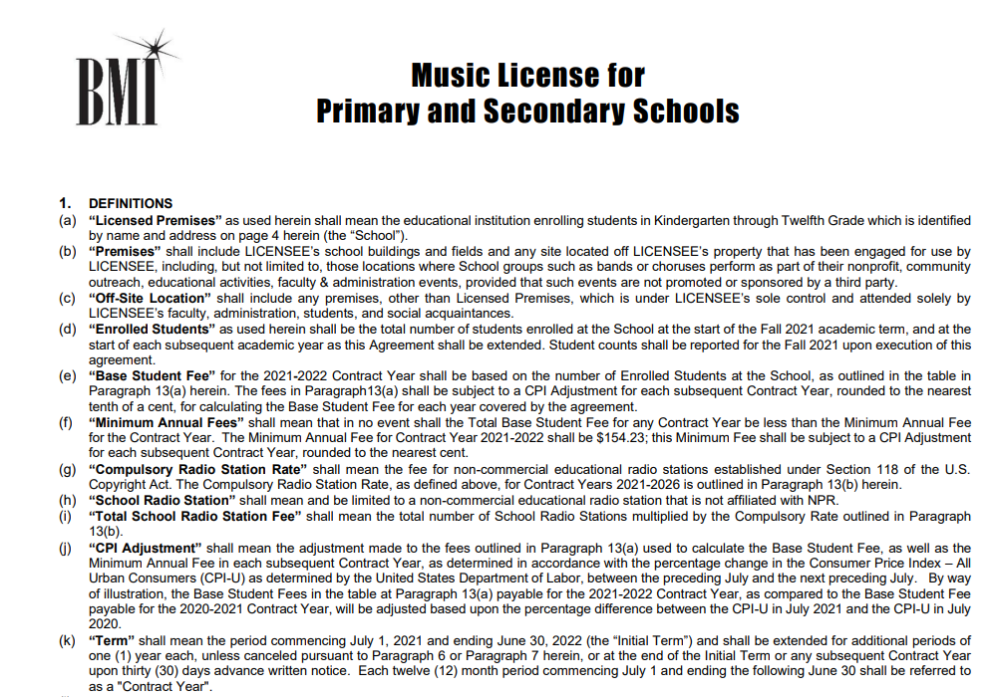
Current Blanket License for High Schools

Slide 17
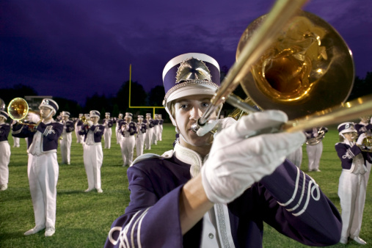
Sporting Events

Slide 18
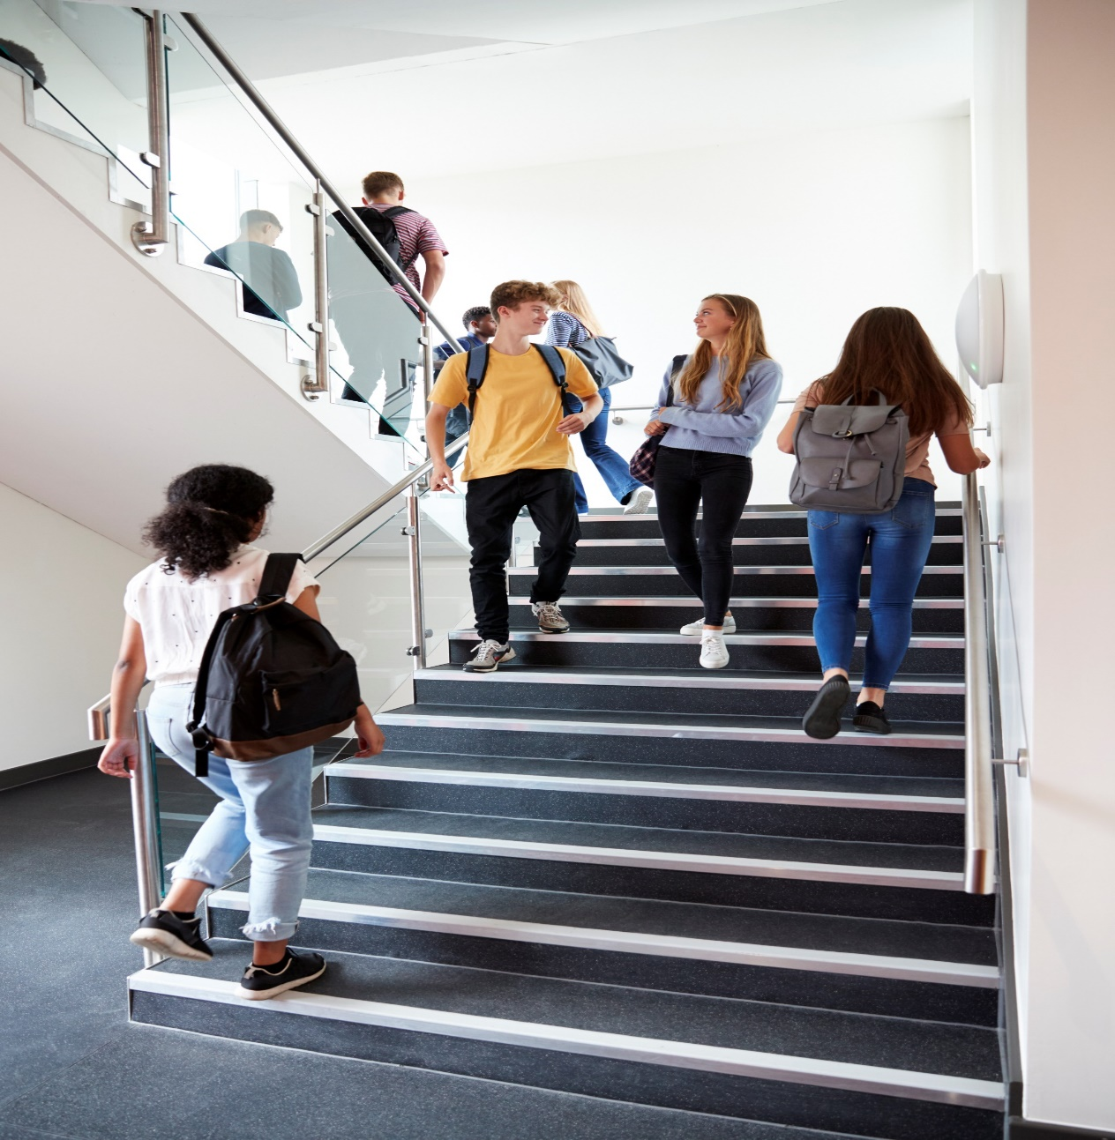
Music Throughout Campus

Slide 19
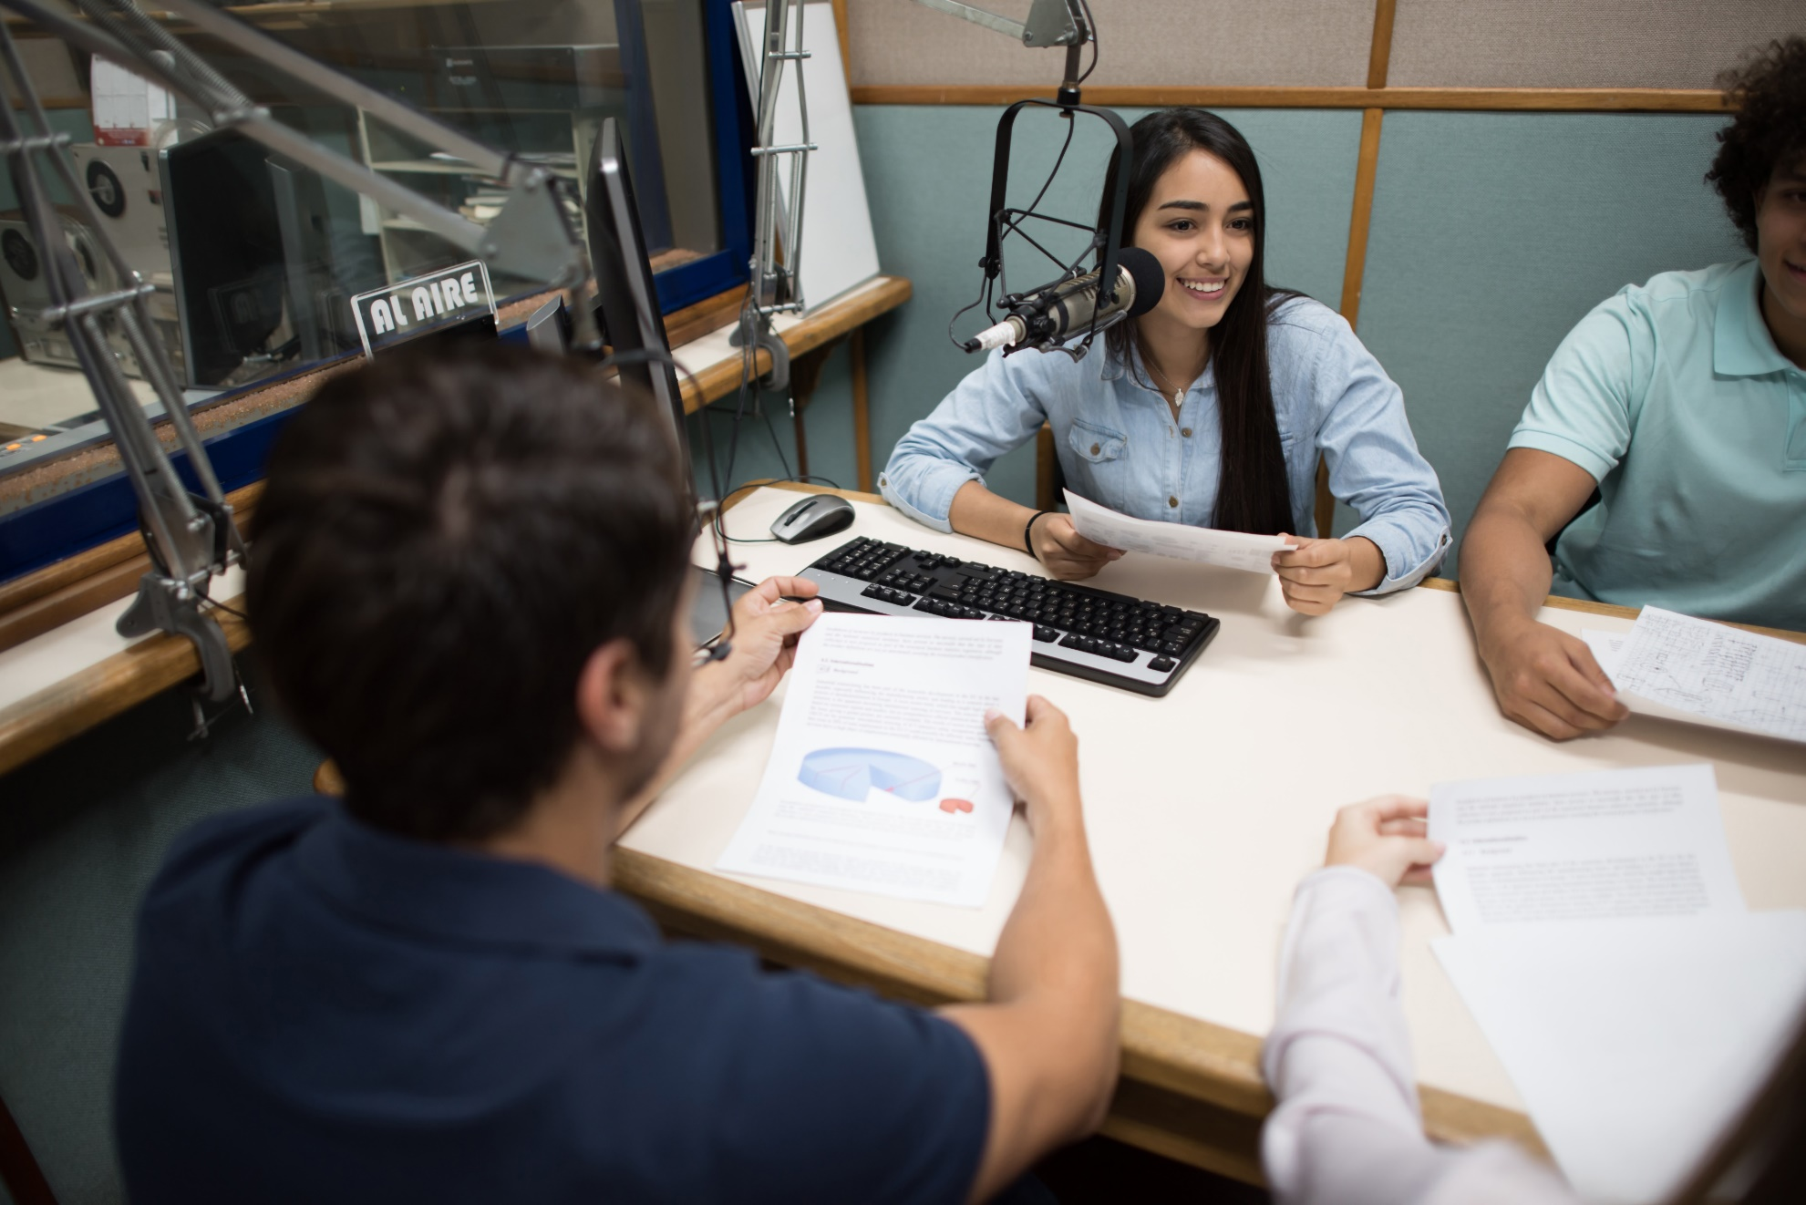
Student Radio Station

Slide 20
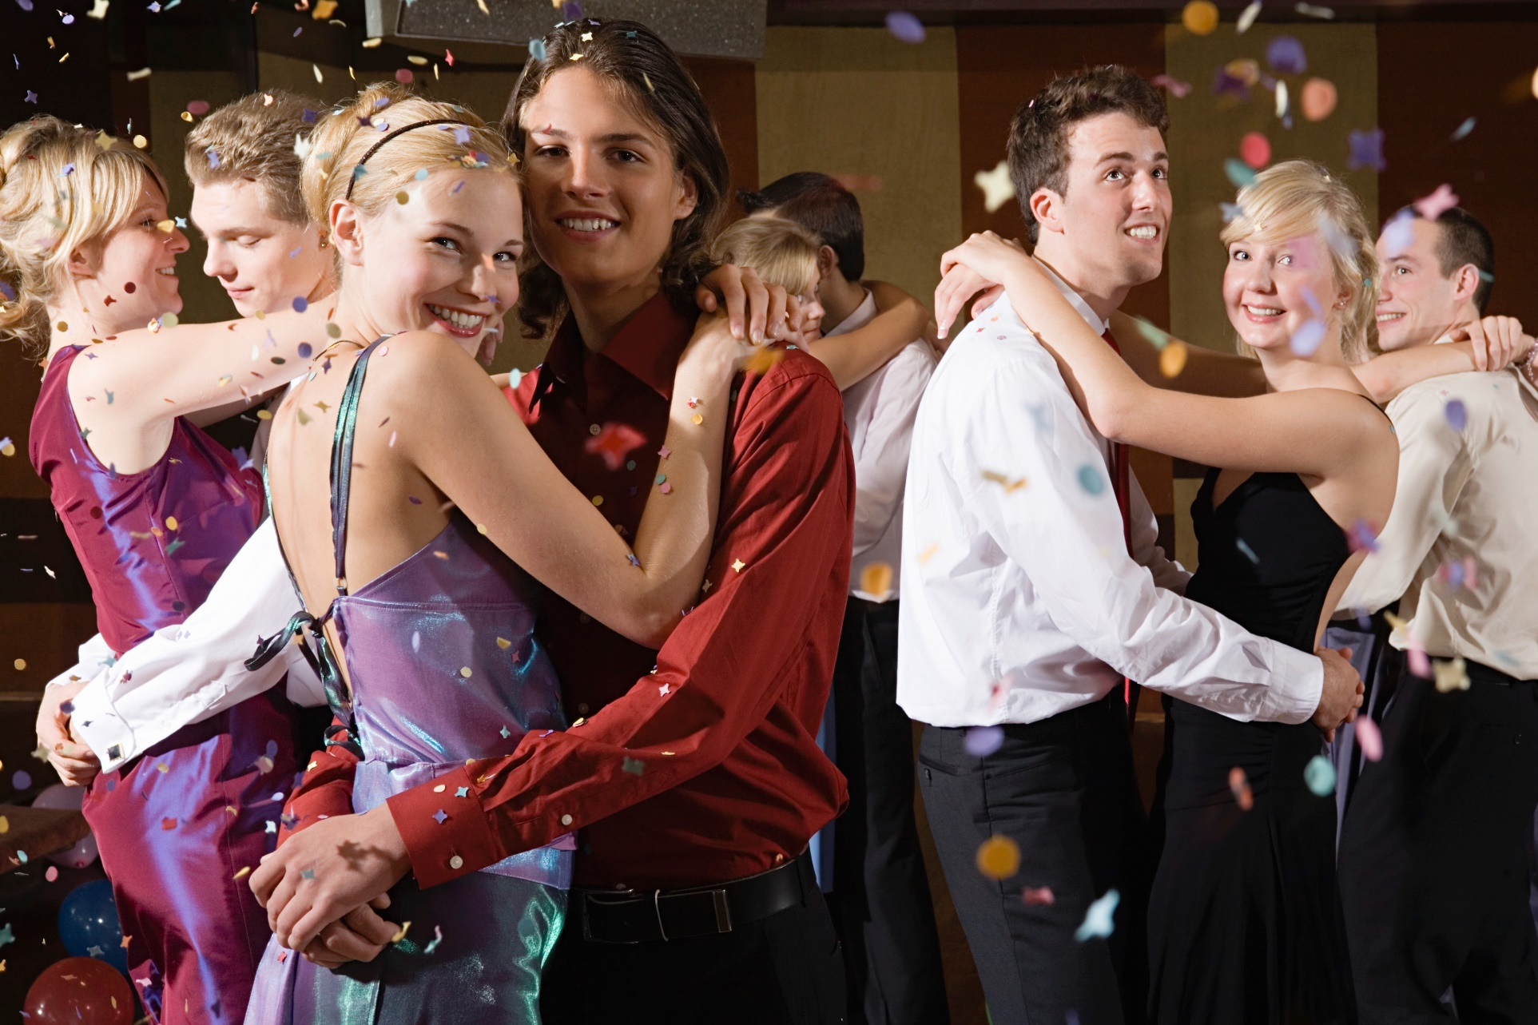
Dances & Social Events

Slide 21

Graduation

Slide 22

Faculty Parties

Slide 23
Premises
All school buildings
All Fields or other property
Offsite locations
  Engaged For Use By Licensee
  Attended by LICENSEE’s students, and social acquaintance
    Community Outreach
    Educational Activities
    Not Promoted By 3rd Party

Slide 24
Performances – Live / Recorded
Concerts
Stage Shows
Variety Shows
Symphonies
Operas
Recitals
Chamber Music
Other Similar Performances
Website
Intranet
School Radio Station
Closed Circuit TV
Ambient Music
  TV’s
  Radio
  iPod, CD’s, etc.
  Streaming Music Services

Slide 25
Primary/School License Agreement
Term – July 1st – June 30th
Automatic Renewal
Cancellation – 30 Day Notice
Annual Renewal Invoice – July
Reporting of Musical Works
Base Student Fee
School Radio Station Fee
Locations rider available for School Districts

Slide 26
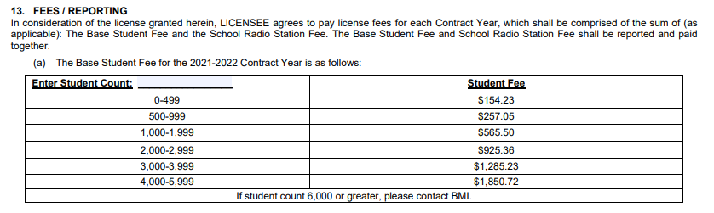
Base Student Fee

Slide 27
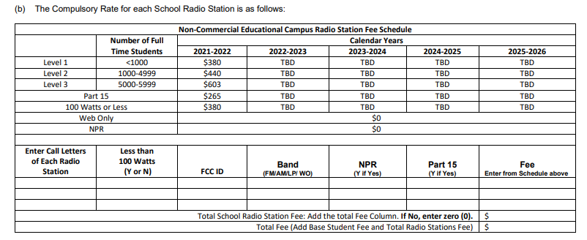
Student Radio Station Fee

Slide 28



Streaming Performances
YouTube
Instagram
Facebook

Slide 29
Where Does The Money Go?
BMI doesn’t make any profit from music licensing fees.
In fact, 90 cents of every licensing dollar BMI collects goes back to our affiliated songwriters, composers and music publishers so they can continue to do what they do best, write great music.

Slide 30
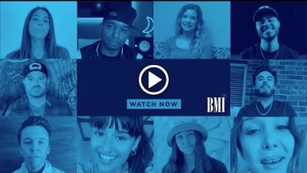
Thank you!

Slide 31
Music Moves Our World

