Slide 1
economic inequality: Affirmative
Resolved: The United States federal government should substantially increase fiscal redistribution in the United States by adopting a federal jobs guarantee, expanding Social Security, and/or providing a basic income .
A look at possible affirmative cases, provided by Rich Edwards, Baylor University

Slide 2
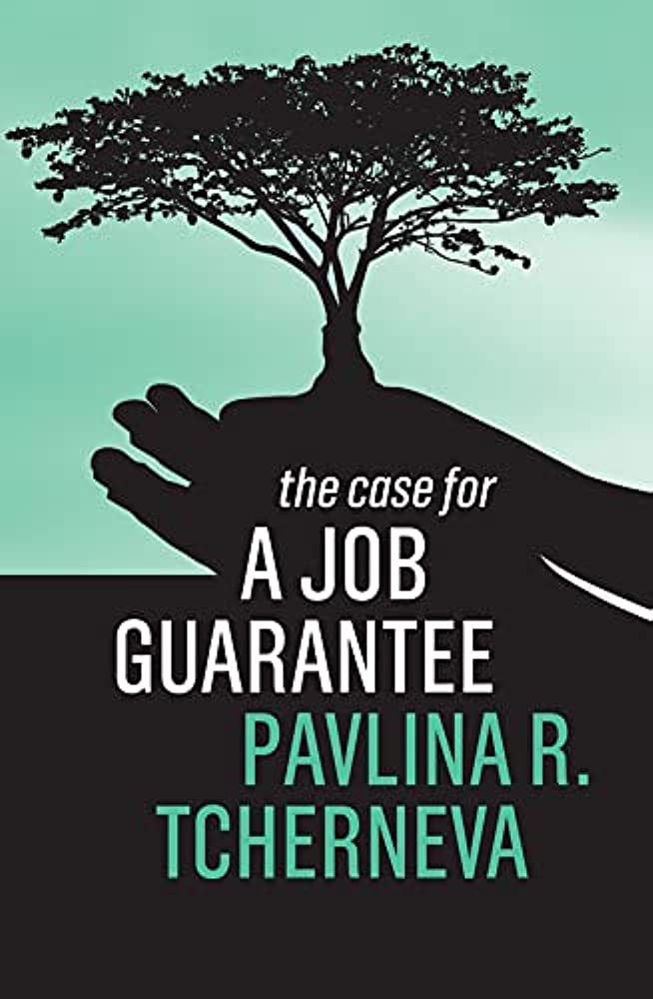
Universal federal jobs guarantee
Harm: Unemployment is extensive and harmful, especially for minorities. Official statistics mask the number of discouraged workers and employed people who remain in poverty.
Inherency: Federal Reserve Board policy perpetuates unemployment.
Solvency: A federal jobs guarantee solves for employment-based racial inequality, generally empowers workers, and creates an automatic economic stabilizer.
$11.07 Online

Slide 3
green new deal
Harm: Climate change is destroying the planet
Inherency: Fossil fuel production is incentivized in the present system
Solvency: A green jobs guarantee would boost the renewable transition and promote energy conservation projects.
$13.39 Online
$35 Online

Slide 4
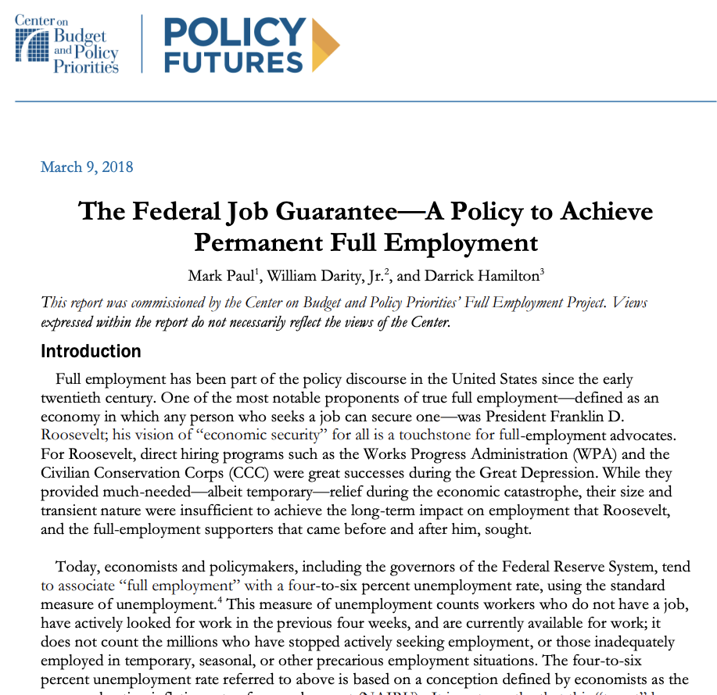
national investment employment corps (niec)
Harm: Tens of millions of discouraged workers have given up looking for work, leaving families in poverty.
Inherency: The free enterprise system is incapable of meeting employment needs.
Solvency: The NIEC is the jobs guarantee proposal of the Center on Budget and Policy Priorities; It would create an infrastructure bank that would provide a job, at non-poverty wages, for all citizens above the age of 18 that sought one.
https://socialequity.duke.edu/wp-content/uploads/2019/10/CBPP-Federal-Job-Guarantee.pdf

Slide 5
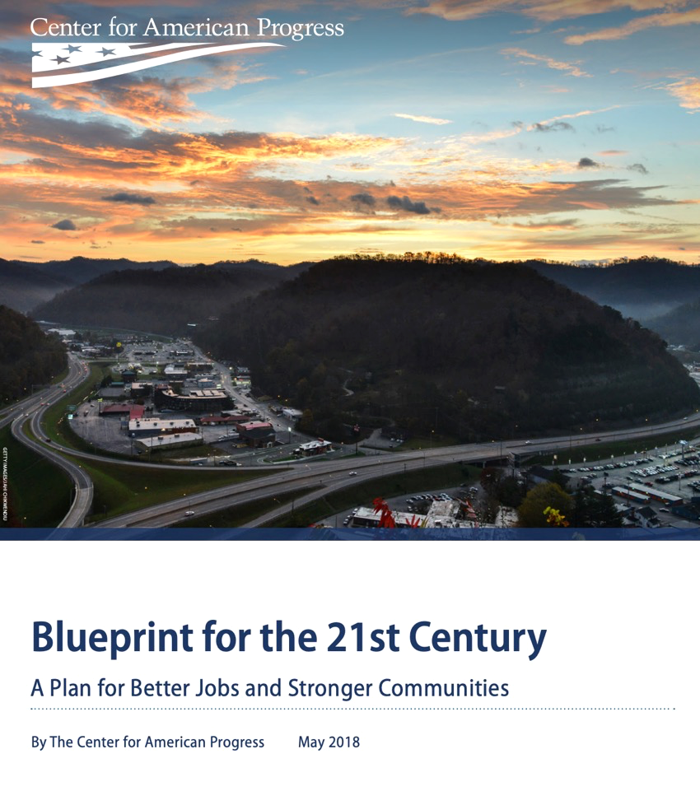
center for american progress plan to save depressed areas
Harm: While the economy is doing well overall, pockets of abject poverty remain, especially disadvantaging minorities.
Inherency: Current tax schemes to assist depressed regions serve little purpose than to give tax breaks to the wealthy.
Solvency: The Blueprint for the 21st Century would create federal jobs in the bottom 10% of counties throughout the U.S. experiencing economic distress.
https://www.americanprogress.org/wp-content/uploads/sites/2/2018/06/JobsBlueprint-report1.pdf

Slide 6
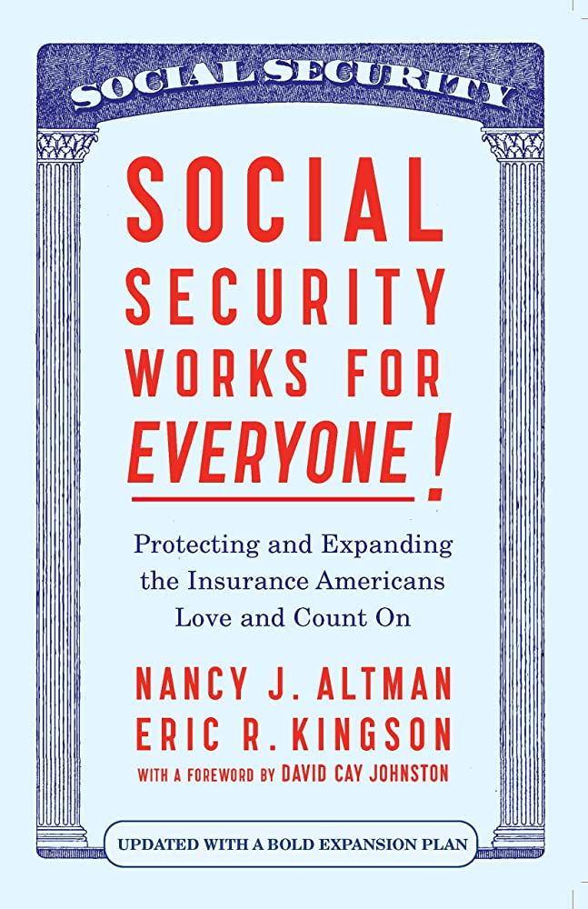
retirement security
Harm: Too many seniors still live in poverty; caregivers – primarily women – are discriminated against in the current Social Security retirement system.
Inherency: Social Security taxation favors the rich
Solvency: Expanding Social Security will bring elderly recipients out of poverty. The “All Generations Plan” would provide fairness in retirement for women and for persons who took a break in their working years to provide unpaid caregiving for children, spouses, or parents.
$15.39 Online

Slide 7
What is included in “social security?”
Official Website of Social Security: https://www.ssa.gov/OP_Home/ssact/ssact-toc.htm
Entitled: “Compilation of the Social Security Laws”
Title II: Federal Old-Age, Survivors, and Disability Insurance Benefits (OASDI)
Title X: Grants to States for Aid to the Blind
Title XIV: Grants to States for Aid to the Permanently and Totally Disabled
Title XVI: Supplemental Security Income for the Aged, Blind, and Disabled (SSI)
Title XVIII: Health Insurance for the Aged and Disabled (Medicare)
Title XIX: Grants to States for Medical Assistance Programs (Medicaid)
Title XXI: State Children’s Health Insurance Program (CHIP)

Slide 8
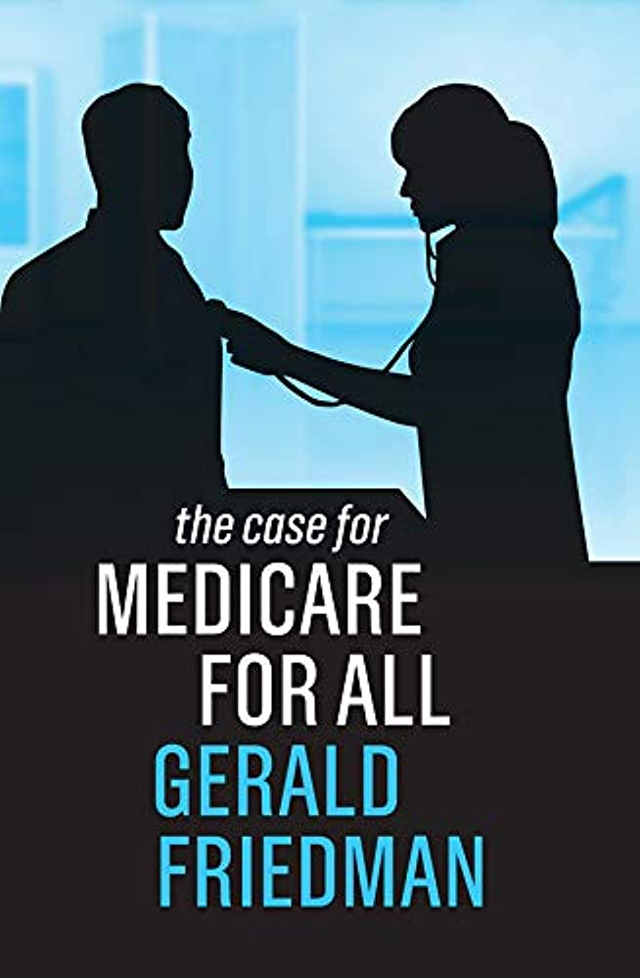
medicare for all
Harm: Americans spend more on health care and get less in return than residents in most other advanced nations. Uninsured people avoid needed health care.
Inherency: The current employment-based health insurance system is defective and totally fails during economic downturns or pandemics when people are losing their jobs; private insurance overhead costs are too high.
Solvency: Medicare for All would cover all currently uninsured persons; quality would increase, and cost would decrease. Administrative cost would be tiny compared to private insurance costs.
$12.35 Online

Slide 9
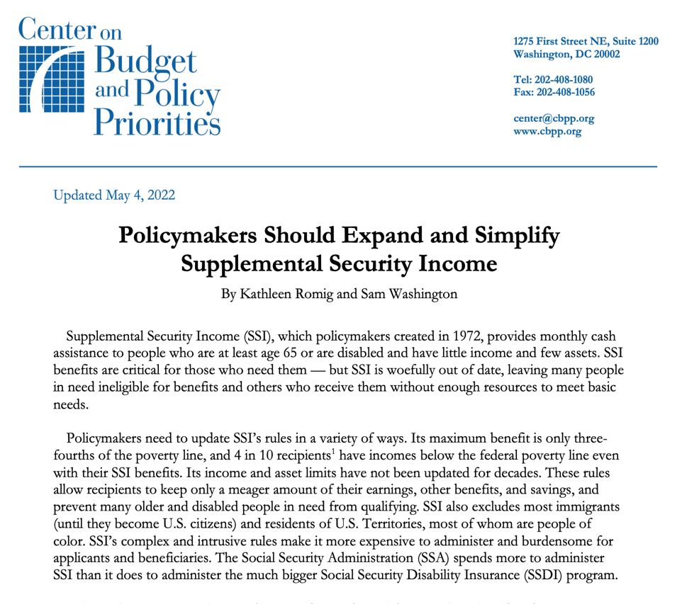
supplemental security income (ssi)
Harm: Persons with disabilities are too often denied coverage and even those who qualify have benefit levels that are too low.
Inherency: Asset limits have not been updated for decades; the $2,000 asset limit excludes many worthy persons with disabilities.
Solvency: Expanding Title XVI of the Social Security Act would provide needed benefits for persons with disabilities.
https://www.cbpp.org/research/social-security/policymakers-should-expand-and-simplify-supplemental-security-income

Slide 10
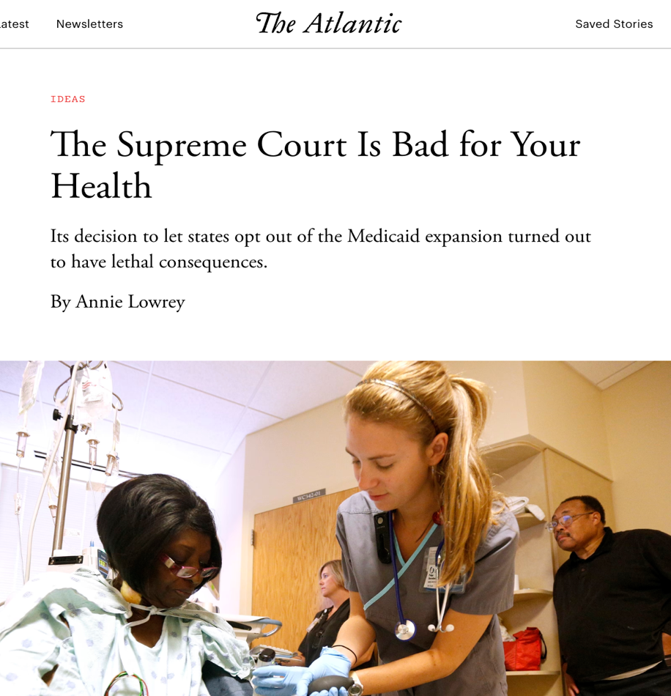
medicaid expansion
Harm: Failure to expand Medicaid in the 10 non-expansion states results in thousands of deaths due to inadequate access to health care.
Inherency: The 2012 Supreme Court Decision in NFIB v. Sebelius prevents Medicaid expansion.
Solvency: Expanding Medicaid will save tens of thousands of lives.
https://www.theatlantic.com/ideas/archive/2019/07/medicaid-saves-lives/595096/

Slide 11
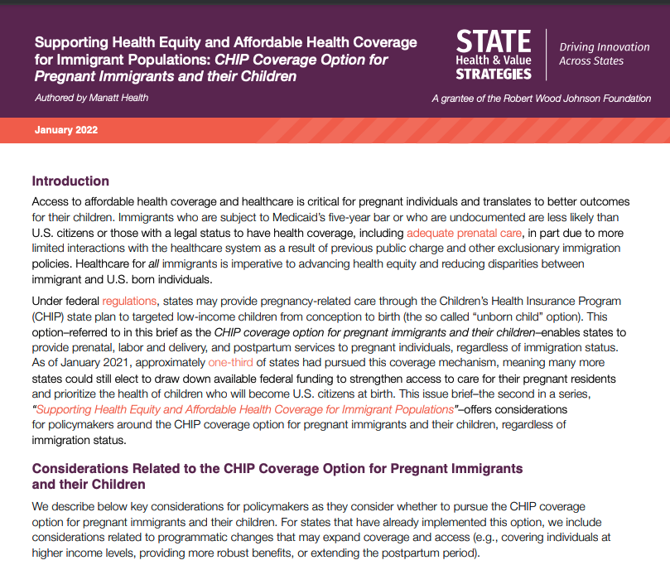
children’s health insurance program (chip) for immigrants
Harm: Immigrants, many of whom are children, are uninsured and lack adequate health care
Inherency: Immigrant children are currently blocked from participation in CHIP in most states.
Solvency: Health Equity and Access under Law (HEAL) would provide CHIP coverage for immigrant children.
https://www.shvs.org/wp-content/uploads/2022/01/Supporting-Health-Equity-and-Affordable-Health-Coverage-for-Immigrant-Populations_CHIP-Coverage-Option-for-Pregnant-Immigrants-and-their-Children.pdf

Slide 12
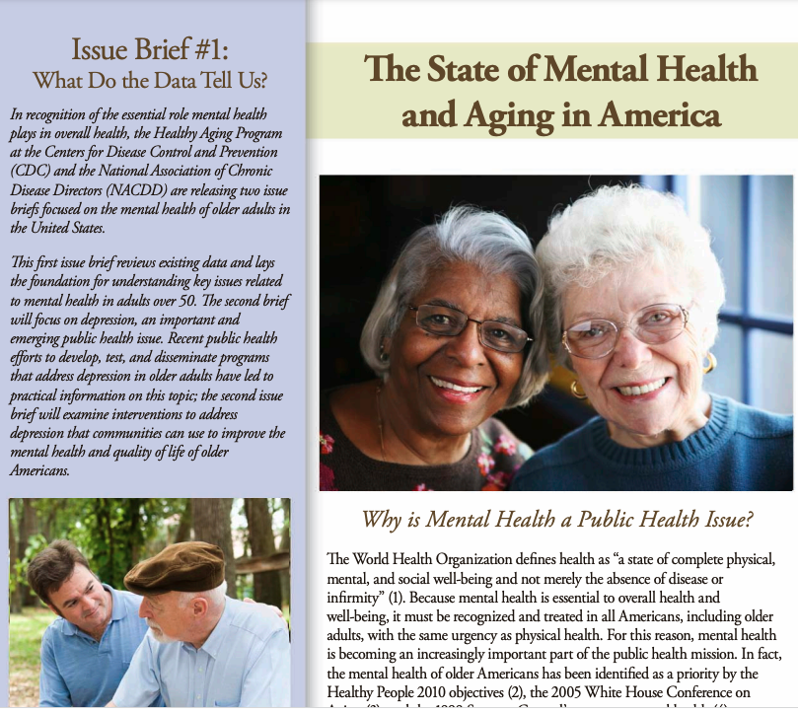
mental health care in social security
Harm: Mental health and substance abuse disorders are serious problems for the elderly population.
Inherency: Coverage limits in Medicare make appropriate mental health care impossible.
Solvency: Increasing coverage for mental health issues and removal of the 190-day lifetime limit will substantially improve health care for the elderly.
https://www.cdc.gov/aging/pdf/mental_health.pdf

Slide 13
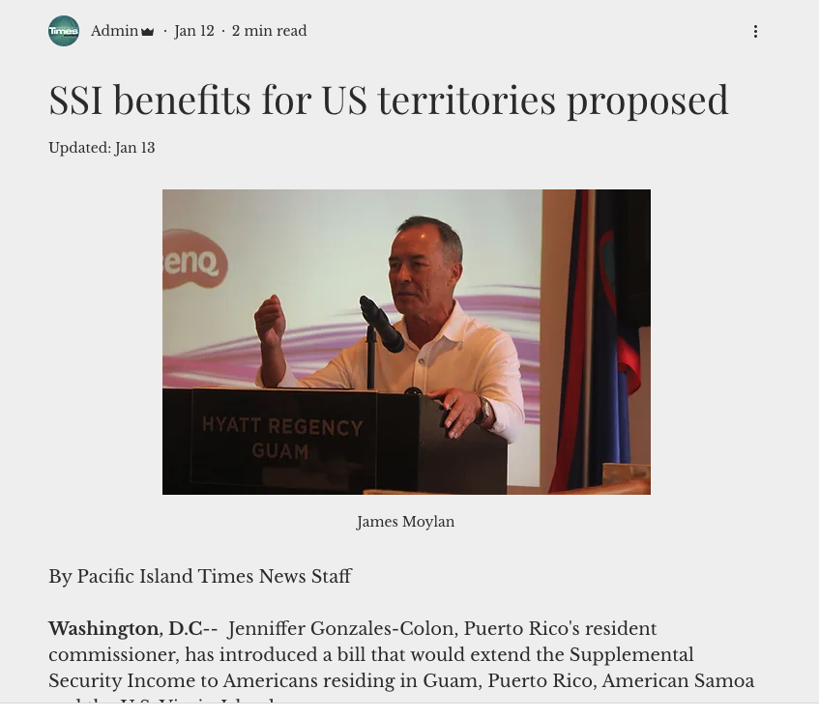
supplemental security income in the u.s. territories
Harm: Persons with disabilities in the U.S. territories, such as Puerto Rico, do not receive the vital assistance available to other U.S. citizens.
Inherency: Supreme Court case in U.S. Vaello-Madero ruled that Congress didn’t intend SSI to go to the territories.
Solvency: Adopt H.R. 245 extending SSI disability benefits to citizens in the U.S. territories.
https://www.pacificislandtimes.com/post/ssi-benefits-for-us-territories-proposed

Slide 14
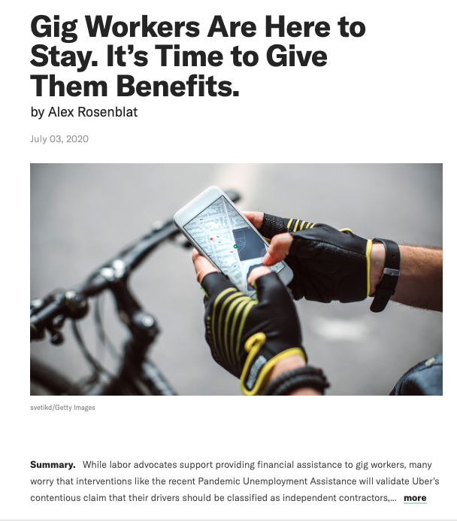
expand unemployment insurance
Harm: There are now huge numbers of gig workers in the U.S. because companies have found they can save money by defining their workers as independent contractors, rather than as employees with benefits.
Inherency: Unemployment insurance for gig workers, provided during the pandemic, has now reverted to no coverage.
Solvency: Provide unemployment insurance for gig workers.
https://hbr.org/2020/07/gig-workers-are-here-to-stay-its-time-to-give-them-benefits

Slide 15
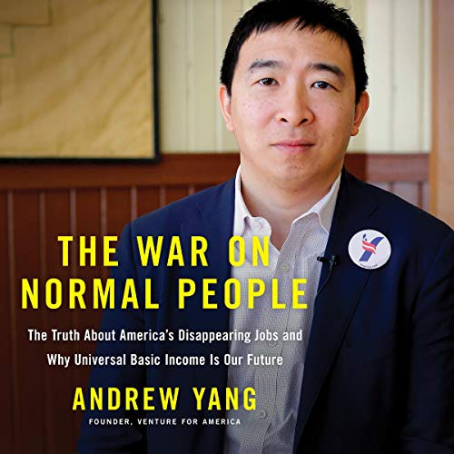
universal basic income
Harm: AI and automation will eliminate half of U.S. jobs, creating dramatic societal dislocations.
Inherency: Current federal taxation structure incentivizes conversion of labor to AI-based replacements.
Solvency: Give everyone money so that they can be safe from the impacts of unemployment and freed to do what they want to do.
$9.94 Online

Slide 16
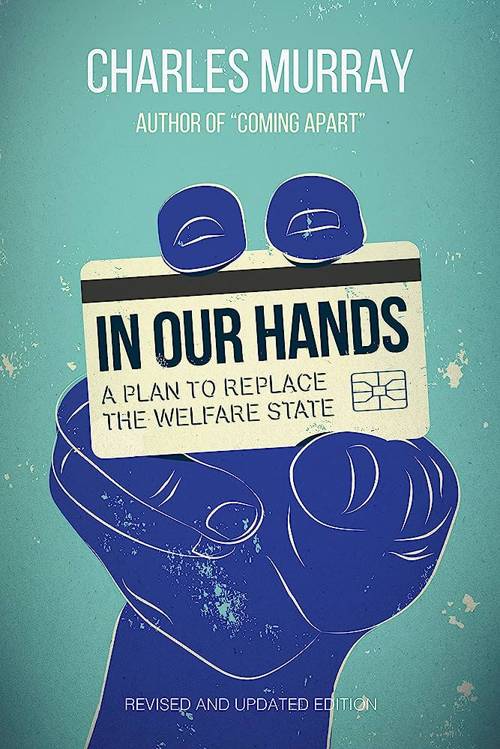
a universal basic income: the conservative case
Harm: The bureaucracy required to sustain the current “means-testing” structure of welfare wastes money – money doesn’t get to the poor. Means-testing is also demeaning; it also gives the government far too much power over peoples’ lives.
Inherency: All current welfare systems require means-testing.
Solvency: Eliminate the current means-testing welfare system and just give everyone money.
$12.02 Online

Slide 17
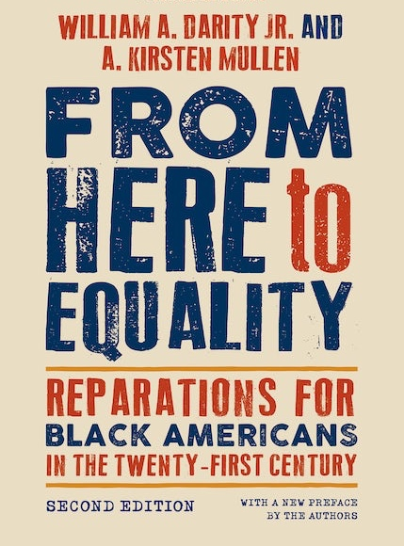
reparations
Harm: The wealth gap continues to disadvantage black Americans; this is the residue of slavery, but discrimination continues to disadvantage even those who are not the descendants of slaves.
Inherency: The U.S. tax code advantages those with savings and assets, thus perpetuating the impact of past discrimination
Solvency: The UBI is an equalizer, but a reparations solution that avoids the necessity to figure out who should pay and who should receive.
$20 Online

Slide 18
economic inequality: Affirmative

